Slide 1
StyleGAN 2
David Rose

Slide 2
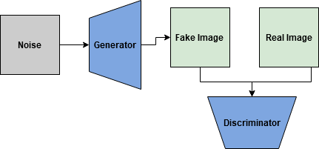
What is a GAN?
Generator
Make images from noise (“latent variables”)
Discriminator
Distinguish between generated and real images
Like a basic sigmoid classification model

Slide 3
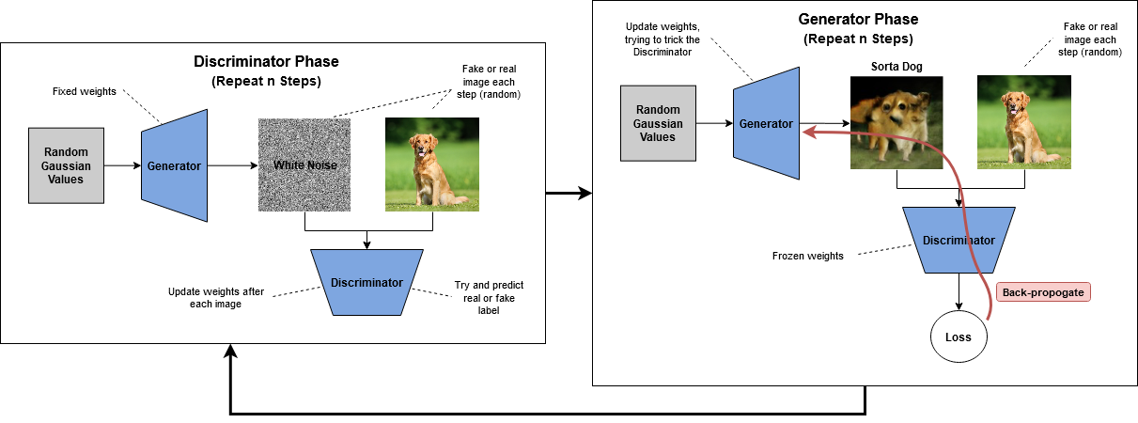
Example Training Iteration

Slide 4
What Is Good Performance?
The Generator
Creates images that cause the discriminator to pass/fail 50% of the time, random choice
The Discriminator
Can correctly predict the class (real/fake) any given image 100% of the time
The Overall GAN
The two phases are seemingly in opposition to each other
So we must create a new metric to capture this!

Slide 5
Original Method
Minimax Loss:
Zero-Sum
The Generator tries to minimize the function, while the Discriminator tries to maximize it, so we can see there is a conflict between the two goals
Stuck Training
As the Discriminator may reliably learn to classify real/fake images, there will be no reliable gradient information, and training gets stuck

Slide 6
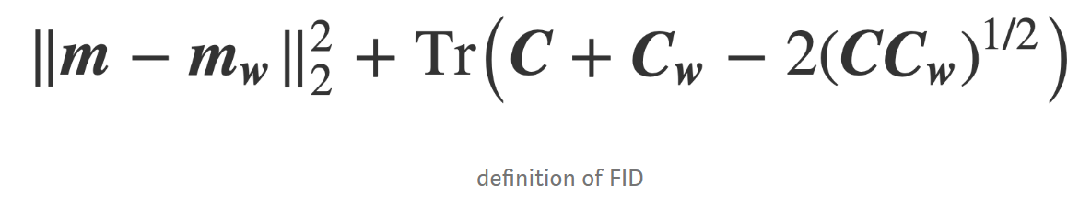
Frechet Inception Distance (FID)
If we can encode to a lower dimension, we can calculate distances
(similarities)
Let’s pass the images to an image model and use the embedding vector statistics!
In this case, the Inception V3 model.
In the embedding space:
m – the mean vectors
C – covariance matrices

Slide 7
StyleGAN Improvements
Progressive Growing
Start with low resolutions, then grow higher
AdaIN
Adaptive Instance Normalization

Slide 8
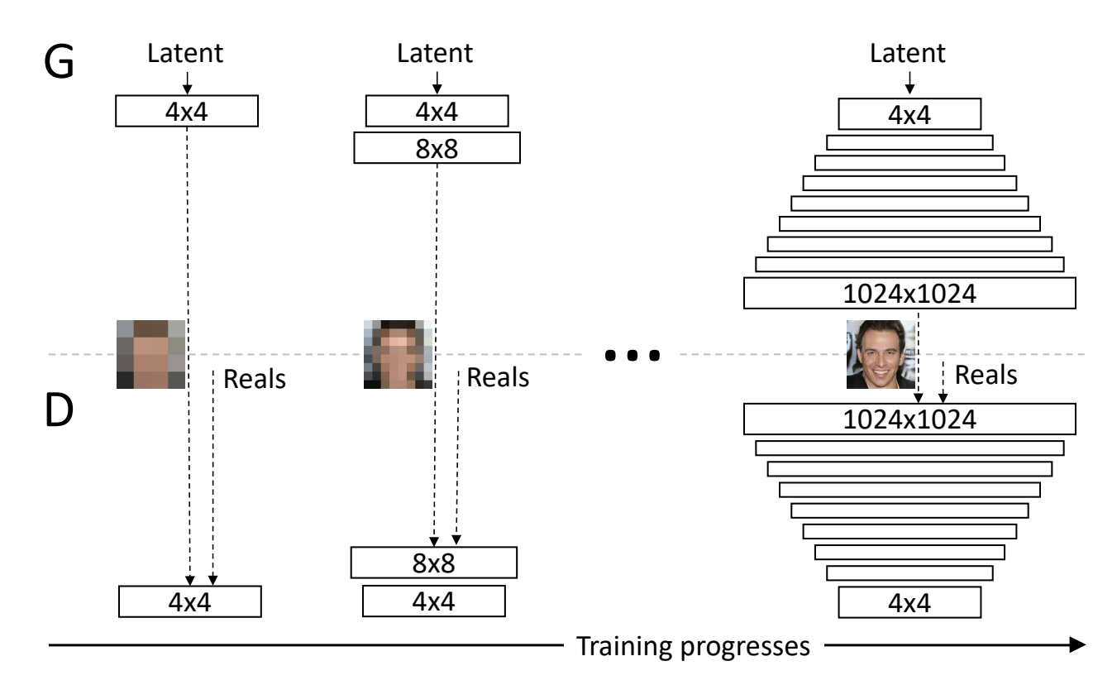
Progressive Growing
Grow from small -> large
StyleGAN implementation:
Start with 4x4 pixels
End with up to 1024x1024 pixels
though compute and memory requirements can get high
On my personal computer I stopped at 512x512, and was able to train in 3-4 days with 3x1080ti

Slide 9
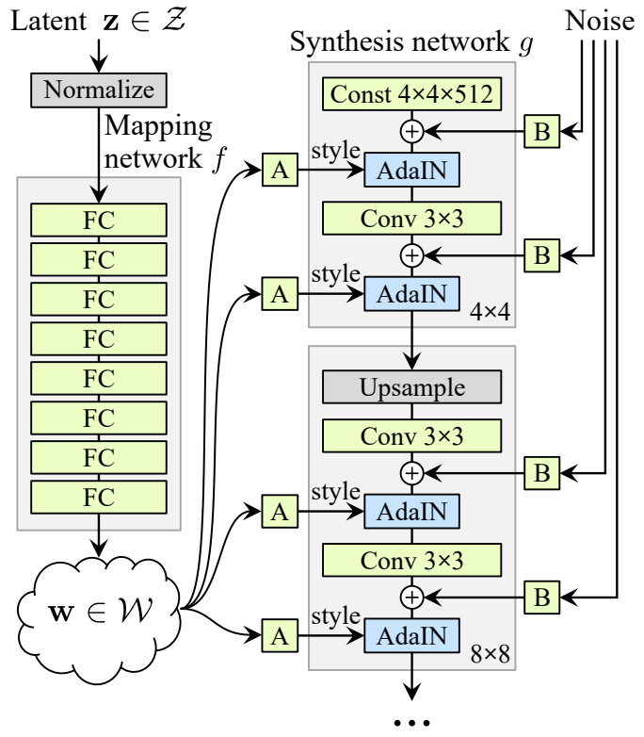
AdaIN
Instead of a single input of noise at the beginning, feature mapping layers are used that include noise at each separate step.
Enables clearer images
a single source of noise creates blur
As a side effect, also allows control of image features
For faces: hair color, gender, etc.

Slide 10
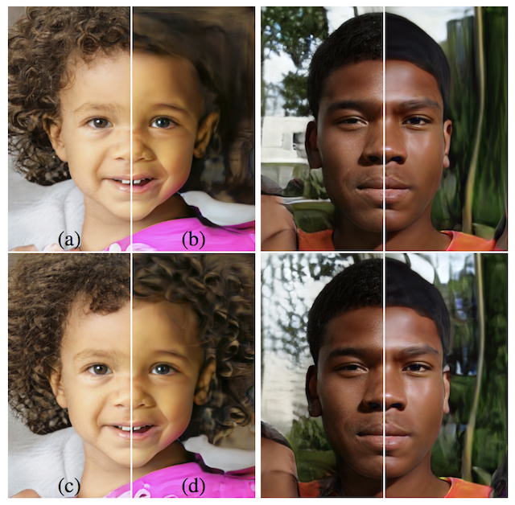
AdaIN
Inserting the noise at later layers allows more fine-grained details to be generated
Too much noise in the beginning is expanded upon when training iterates, prohibiting fine details from emerging

Slide 11
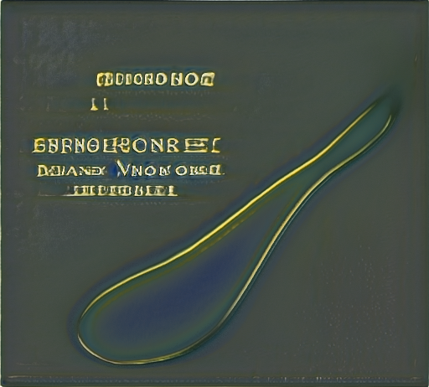
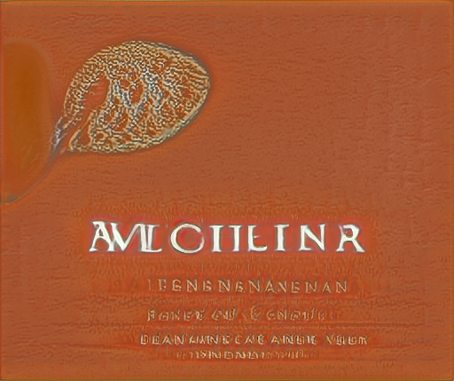
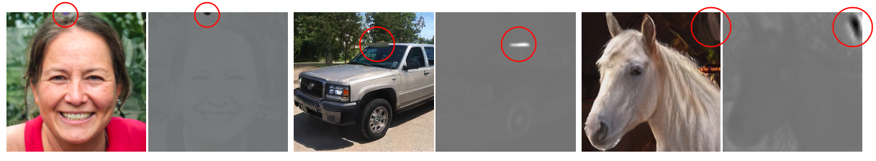
StyleGAN V1 Issues
Artifacts
Seemingly at random, these ‘droplets’ occur at various feature maps
Believed to be introduced in the normalization layer (AdaIN)

Slide 12
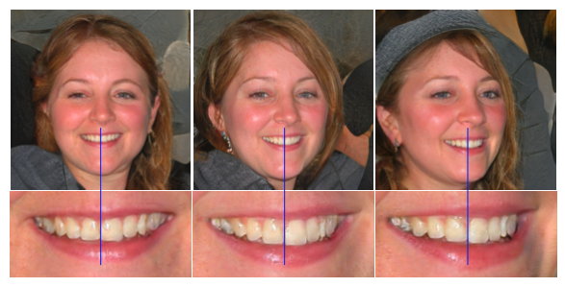
StyleGAN V1 Issues
Mis-Aligned Features
The noise introduced at different feature layers can sometimes cause differences in matching

Slide 13
StyleGAN V2
Upgrade the normalization
Remove AdaIN in factor of a more generic normalization
Use skip connections across the resolution layers

Slide 14
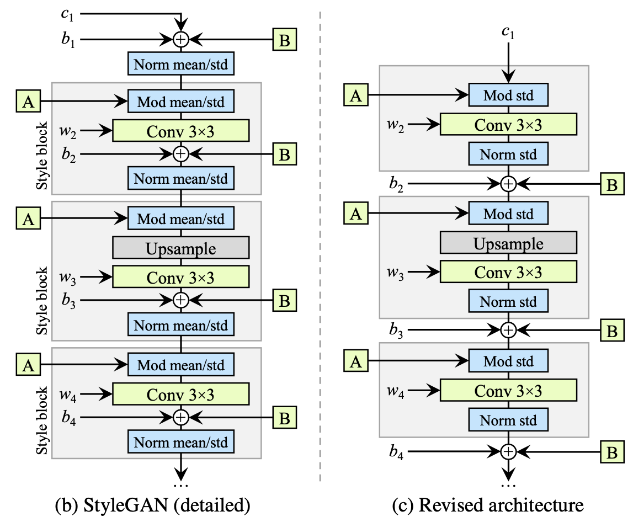
StyleGAN V2
V1
Normalization was previously based on the intra-layer statistics (mean, variance)
This allowed location specific spikes of values to occur
These were later magnified through the resolution up-sampling

Slide 15
StyleGAN V2
V2
Normalize the parameters using estimated statistics
In short: using assumed normal distributions
Caused slight quality issues, but were made up for in other areas

Slide 16
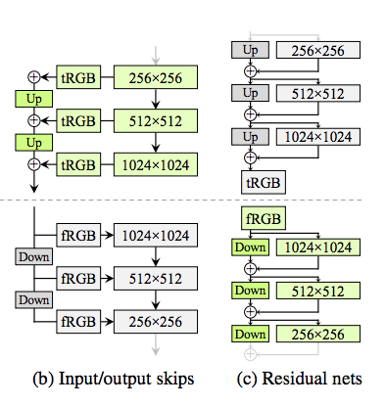
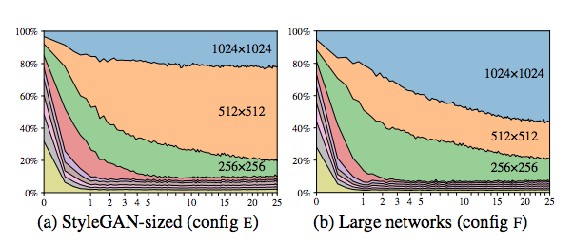
StyleGAN V2
V2
Skip-Connections
Like from Resnet model
Using skips we can control the influence of each resolution, giving larger resolutions more weight

